Slide 1

Latent Variable Models of A Learning Brain
By Arnold Cheskis
Kabir Dabholkar
Omri Barak

Slide 2
Background
Latent variable models (LVMs) are used to capture the dynamics of neural circuits given recordings of signals from the brain
LVMs assume that the dynamical system remains fixed. However, the brain is continuously evolving with time, i.e. ’learning’
We study the novel scenario of fitting LVMs to a learning brain using a student-teacher setting (“How?” slide)
Notes:
Talk about HMM

Slide 3
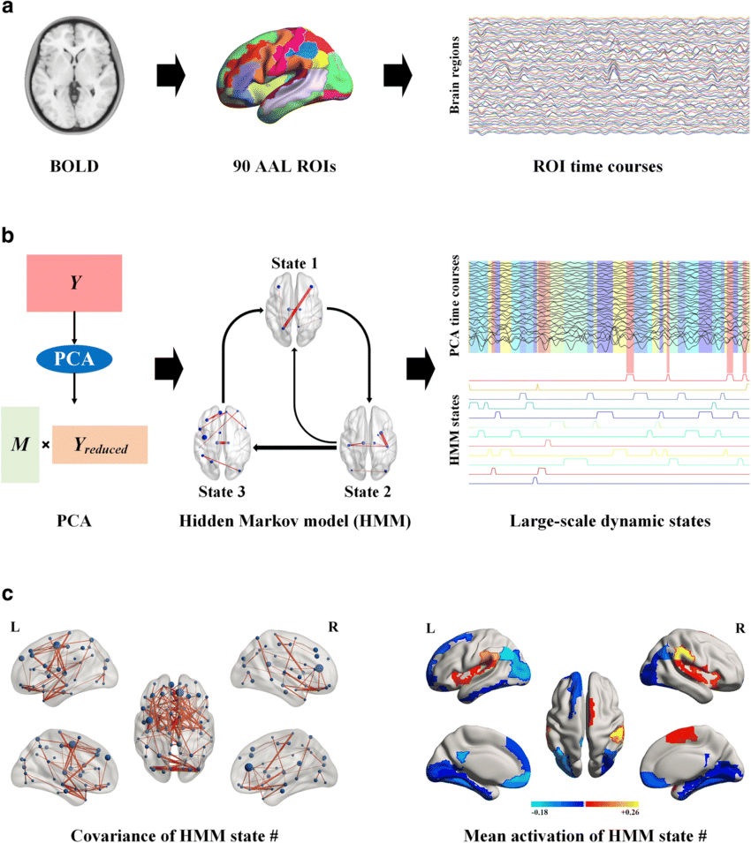
Goal (as of today)
Deduce whether the learning process could help discriminate “bad” models.

Slide 4
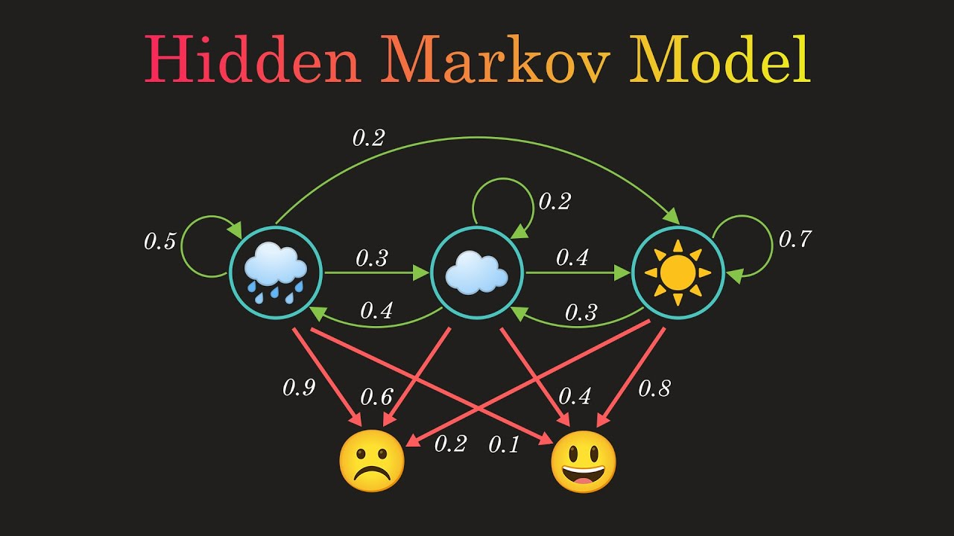

Hidden Markovian Models (HMMs)
HMM is a NN structure that is uniquely defined by the tuple $(A, π, \left\{μ,Σ\right\})$
To train an HMM we must get the emissions from the trials. A trial is a trajectory of observations, $p\left(v_{1:T}\right)$, which we obtain through the following steps:
Sample the initial hidden states using the initial distributions π. We can get, for instance, $h_{1}=3$.
Sample the following hidden states using the transition matrix. E.g., if $h_{1}=3 then$ we sample $h_{1} \text{from} p(h_{2}|h_{1}=3)$
Similarly, we repeat the process for $h_{3},h_{4},…h_{T}$
Finally, using the emission matrix, $\left\{μ,Σ\right\}$, we sample the observations $p(v_{0:T})$ from $p\left(v_{t} | h_{t}\right) , ∀t∈\left[T\right]∪\{0\}$
Using optimization algo (e.g. GD) we then find the optimal parameters ($A_{student}$, $π_{student}$, ${\{μ,Σ\}}_{student}$) which maximize the (log) likelihood, $p\left(v_{1:T}=\left({v^{′}}_{1},{v^{′}}_{2},…{v^{′}}_{n}\right)\right)$ , or minimize the negative likelihood.
Notes:
Explain about the tuple.

Slide 5

How?
Considering a randomly generated model ($T_{0}$, our “ground truth”) to represent the brain, we will model the changes as a series of perturbations on $T_{0}$, giving us $T_{1},T_{2}…T_{k}$ ($T_{i}$ = $T_{i−1}$ + $ε$)
We want to start by training students with several different curricula, $S_{1},S_{11},S_{12},S_{2},S_{22}$ respectively on $T_{1},T_{1}→T_{1},T_{1}→T_{2}$ and so on...
Repeat each curriculum with many randomly initialized students.
Evaluate students 𝑆_1,𝑆_11,𝑆_12,𝑆_2, "and" 𝑆_22 on an unseen teacher 𝑇_3

Slide 6
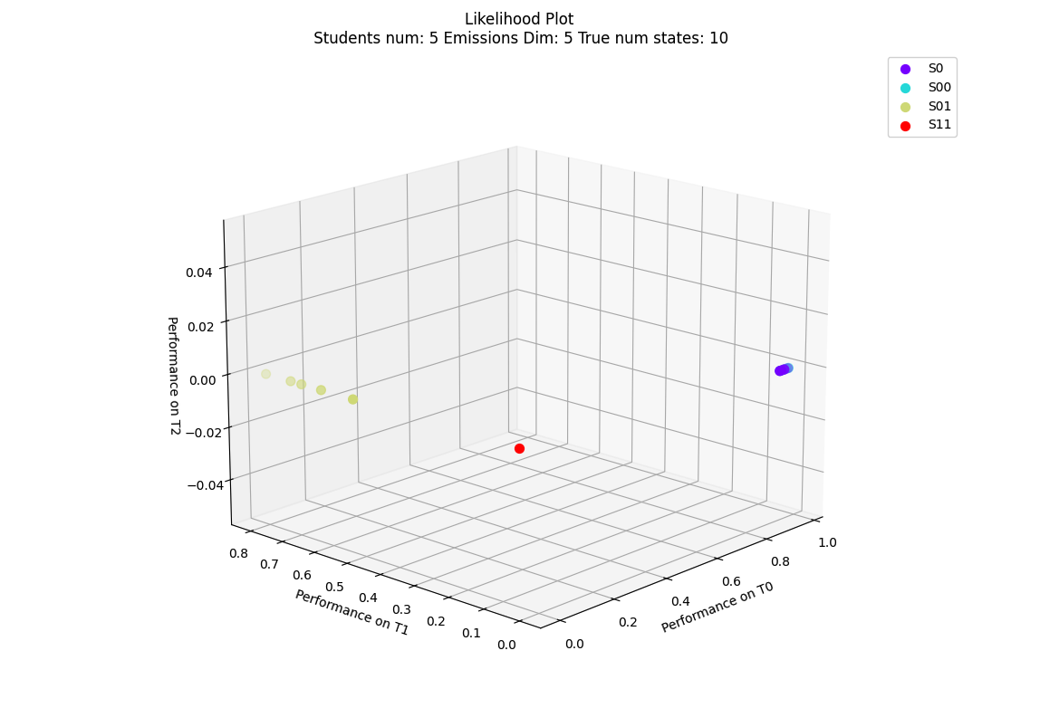
Current results
After familiarizing myself with the framework, I began comparing different settings and training methods for the students.
Notes:
What I was hoping to see S11 is not optimal. Even though there are no grounds to believe that – Discuss in the next meeting. I believe, that if the second perturbation cancels the first, it will be lucrative to utilize the history. Otherwise, only train on the latest model (T1 in this case). So maybe, if we have a lot of perturbations, they might bring us back at some point?

Slide 7
Students with varying of states
Notes:
Here I did expect improvement based on Kabir’s paper

Slide 8

Next steps
Generalize the training to more complex curricula $S_{1},S_{11},S_{12},S_{2},S_{22}…S_{12…k}$ Then, perhaps, we’ll choose the likelihood over $T_{k}$ as one of the axes. For the other/s there are several options. One could be the highest likelihood each model had over any of the models (the detect if ”overfitting” helped), and a third one could simply be a discrete grid [1…k] representing the teacher’s num over which the likelihood of each model was the best.
In addition to our normalized likelihood use cross-decoding to visualize data.
Generalize all the hyper-parameters and try several values for comparison. Hyper-parameters include:
Num of states teachers have
Emissions dimensions
Perturbation types (right now some of the perturbations are diagonal matrices)

Slide 9
Papers
Dabholkar, K., & Barak, O. (2024). When predict can also explain: Few-shot prediction to select better neural latents (arXiv:2405.14425). arXiv. http://arxiv.org/abs/2405.14425
Duncker, L., & Sahani, M. (2021). Dynamics on the manifold: Identifying computational dynamical activity from neural population recordings. Current Opinion in Neurobiology, 70, 163–170. https://doi.org/10.1016/j.conb.2021.10.014
Mathematical models of learning and what can be learned from them—PubMed. (n.d.). Retrieved August 4, 2024, from https://pubmed.ncbi.nlm.nih.gov/37043892/
Pei, F., Ye, J., Zoltowski, D., Wu, A., Chowdhury, R. H., Sohn, H., O’Doherty, J. E., Shenoy, K. V., Kaufman, M. T., Churchland, M., Jazayeri, M., Miller, L. E., Pillow, J., Park, I. M., Dyer, E. L., & Pandarinath, C. (2022). Neural Latents Benchmark ’21: Evaluating latent variable models of neural population activity (arXiv:2109.04463). arXiv. https://doi.org/10.48550/arXiv.2109.04463
https://neurallatents.github.io/
Stanford document about HMM Maybe:
Barak O. Recurrent neural networks as versatile tools of neuroscience research. Curr Opin Neurobiol. 2017 Oct;46:1-6. doi: 10.1016/j.conb.2017.06.003. Epub 2017 Jun 29. PMID: 28668365.

